Slide 1

Phishing Attacks: Recognizing and Avoiding the Threat
Phishing is a common and dangerous cyber threat that can impact individuals and organizations. By understanding phishing tactics and implementing best practices, you can protect yourself and your data.

Slide 2

What is Phishing?
1
Deceptive Technique
2
Impersonation
Phishing is a deceptive tactic where attackers try to trick victims into revealing sensitive information, like passwords and credit card details.
Phishing attacks often involve impersonating legitimate organizations or individuals to gain trust and deceive victims.
3
Malicious Intent
Attackers aim to steal personal data, financial information, or compromise accounts for their own malicious purposes.

Slide 3
Common Phishing Tactics
Spoofed Emails
Social Media Scams
Text Messages (Smishing)
Emails that appear to be from legitimate companies or individuals, but are actually fake and designed to trick recipients.
Phishing attacks through social media platforms, using fake profiles, messages, or links to deceive users.
Phishing attacks using text messages that appear to be from legitimate organizations or individuals, but are actually fake.

Slide 4

Identifying Phishing Emails
Suspicious Sender
Incorrect grammar and spelling
Unfamiliar Links
Sense of urgency or threat
Requests for personal information
Missing security certificates

Slide 5

Detecting Phishy Websites
Website URL
Security Certificates
Look for misspellings or unusual domains in the website's address.
Check for a valid HTTPS connection, indicated by a padlock icon in the browser bar.
Website Content
Be suspicious of poorly designed websites with grammatical errors or unprofessional content.

Slide 6




Social Engineering Scams
Pretexting
Attackers create a believable story or situation to gain trust and manipulate victims.
Baiting
Attackers offer something enticing, such as a free gift or a prize, to lure victims into a trap.
Scare Tactics
Attackers use fear or threats to pressure victims into taking action, like revealing sensitive information.

Slide 7

Protecting Yourself and Your Organization
1
Strong Passwords
Use unique and strong passwords for each account and consider using a password manager.
2
Two-Factor Authentication (2FA)
Enable 2FA on all important accounts, which requires an additional code sent to your phone or email.
3
Security Software
Install and update antivirus software and firewall on your devices to protect against malicious threats.
4
Employee Training
Train employees on how to recognize and avoid phishing attacks, as well as proper cybersecurity best practices.

Slide 8
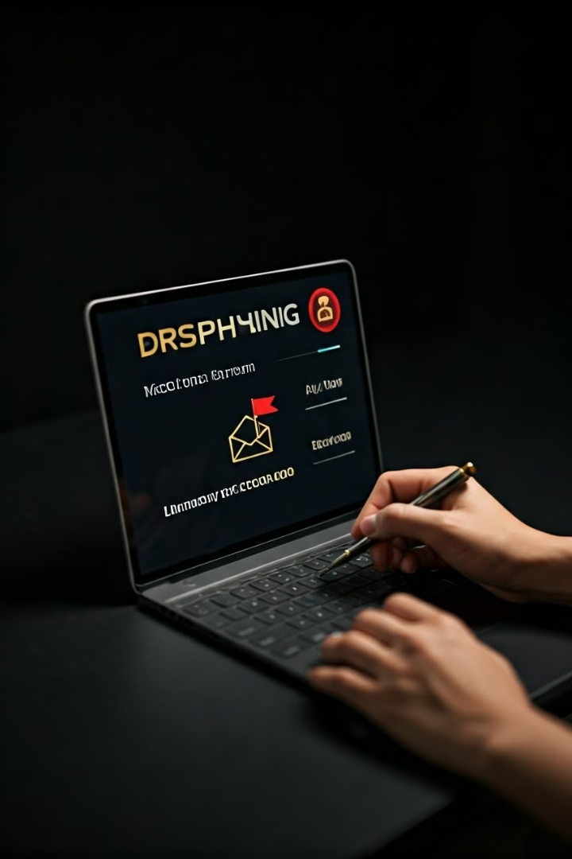



Reporting Suspected Phishing Attempts
Report to Your Email Provider
Forward suspicious emails to your email provider, as they can help identify and block phishing scams.
Contact Your Organization's Security Team
If you work for an organization, report any suspected phishing attempts to your security team immediately.
Report to Law Enforcement
If you believe you've been a victim of a phishing attack, report the incident to the appropriate law enforcement agency.

Slide 9

Best Practices for Phishing Prevention
1
Hover Over Links
2
Verify Sender Identity
Before clicking on any link in an email or message, hover your mouse over it to see the actual URL.
Always double-check the sender's email address and confirm their identity before responding to any requests.
3
Be Cautious of Urgency
4
Keep Software Updated
Phishing emails often create a sense of urgency or fear to pressure victims into taking action, so be cautious of such tactics.
Regularly update your operating system, antivirus software, and browser to patch security vulnerabilities and stay protected.

Slide 10

Conclusion and Resources
Phishing attacks are a constant threat, but by staying informed and following best practices, you can protect yourself and your organization from these scams. Continue to educate yourself about phishing and stay vigilant against these attacks.
US-CERT: Phishing

